Slide 1
PE BAKING LIKE GRANdMA USED TO
MATTEO MALVICA - mnemonic
Notes:
Even though I love cooking in my spare time I still have have the burden of my italian citizenship) this is not going to be about food unfortunately, as you might have guessed by the context from today’s meetup.
Sorry for disrupting everyone’s culinary dreams today :D
Instead, this is about binary exploitation , and in particular windows PE, Portable Executables.
I am going to talk about PE baking or, if you prefer, PE backdooring :) and how evade off the shelf- endpoint security.

Slide 2


@whoami
Security Consultant @ mnemonic [TRS]
pentester/exploitdev
OSCP/OSCE/GXPN/CCIE
drummer
@matteomalvica

Slide 3
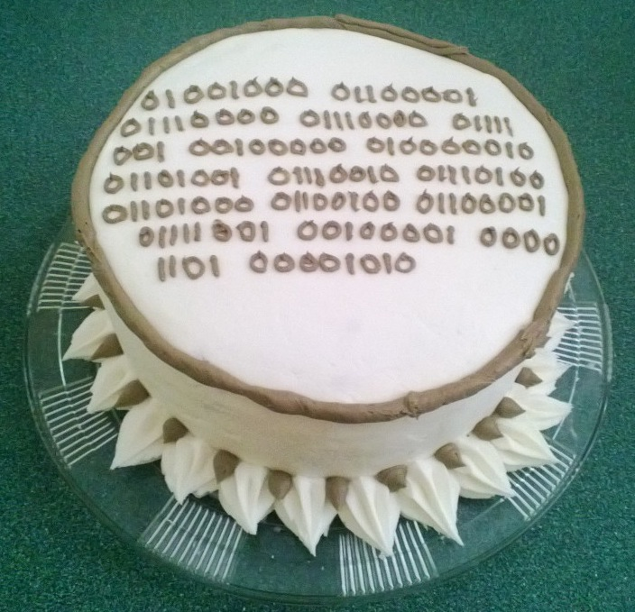
Notes:
In order to cook a tasty binary cake we need gather the right ingredients.
The overall strategy for this PoC is to: pick a legit binary, find some unused space, place a shellcode, encode it on disk, and decode it at runtime.

Slide 4
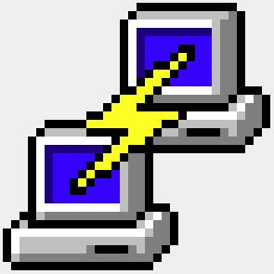


RECIPE’s INGREDIENTS
A popular binary
XOR encoder
Code Caves
Shellcode
Execution Hijacking
Notes:
We have to pick some ingredients for our recipe…[explain each]

Slide 5
BINARY OBFUSCATION - SOME OPTIONS
POLYMORPHISM
PAYLOAD ENCRYPTION
Notes:
when it comes to payload obfuscation, we have some options
Polymorphism is about using functional equivalent instructions, to avoid signature detection. So that the each computed hash will be different.
1.
i.e there are many ways of storing data in a register, for example…
push data and then pop it into a register
move data into a register
clear register and then add data to the register
2.
Or we can just have an encryption stub, which can be AES, RC4, or the easier XOR :)
XOR has a nice symmetrical feature: data that has been encoded with i.e. 0xAA ,it can be then decoded with the same value.

Slide 6
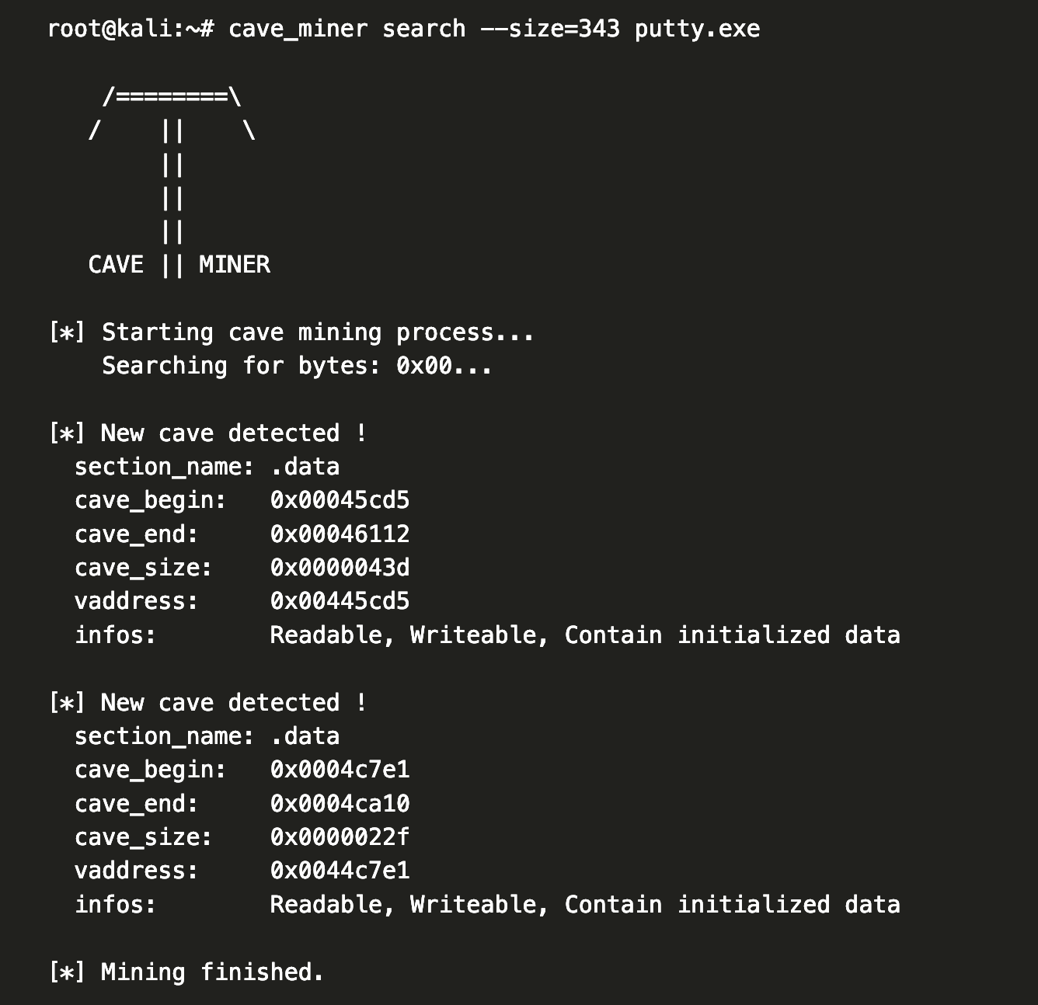
CODE CAVES
FOR THE SHELLCODE [CC1]
ENCODER/DECODER [CC2]
Notes:
What are code caves?
One of them must be of at least 343 bytes, enough to contain shellcode size
The first code cave found is big enough to fit both shellcode and xor stub.

Slide 7
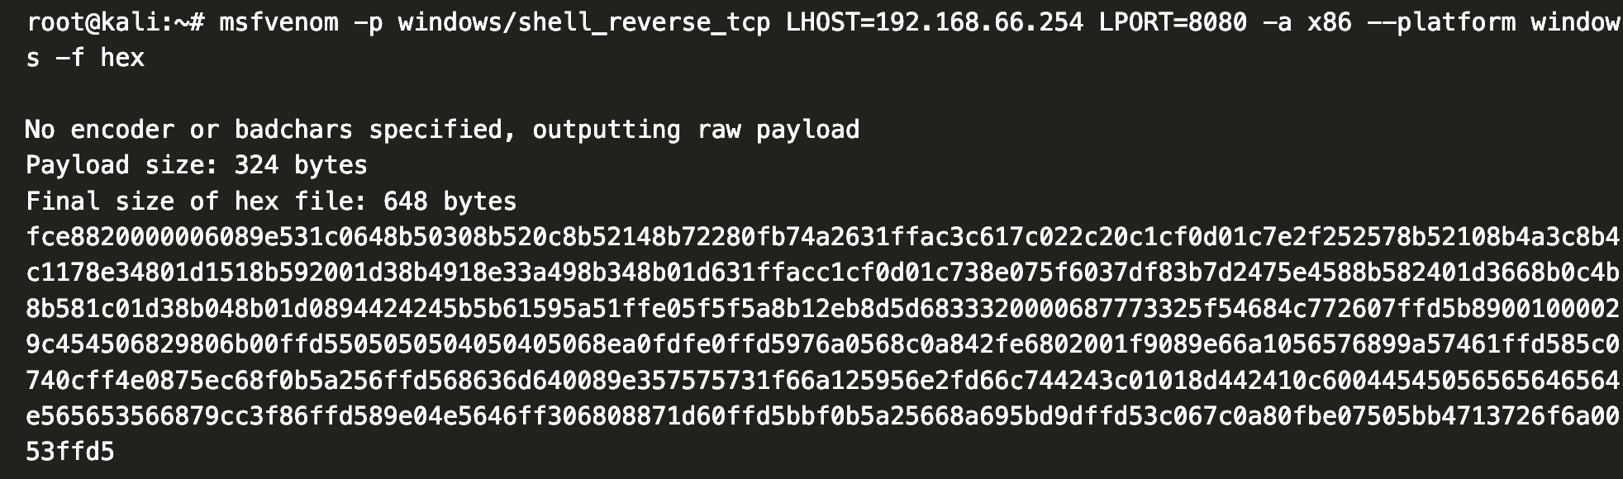
CC 1
SHELLCODE CODE CAVE
Notes:
We can generate the shellcode via our old friend msfvenom.
This generated code is a reverse shell which will connect back to our attacking machine.
We can paste this in the code cave.
Mind to save/restore registers and align the stack at the end of it, so we can revert the original process to its previous state.

Slide 8
CC 2
XOR STUB (only 50 bytes long)
MOV EAX, 00445CDE Place the starting address of shellcode to EAX.
XOR BYTE PTR DS:[EAX],0E Exclusive OR the contents of EAX with key 0E
INC EAX Increase EAX to move to next addresses
CMP EAX, 00445e36 Compare EAX with the ending address of shellcode
JLE SHORT 00479733 If they are not equal, take a short jump back to XOR
JMP 00445CDE if they are equal jump to shellcode start
Notes:
This is going to be placed right after the shellcode, since we have enough space.
This is where the hijacked program execution will land first.
Will take care of encoding (beforehand) and decoding at runtime.
Once we have copied the stub at CC2 location, we can give it a run, so it will encode the shellcode.
Once encoded we can save the file, ready for malicious use.

Slide 9
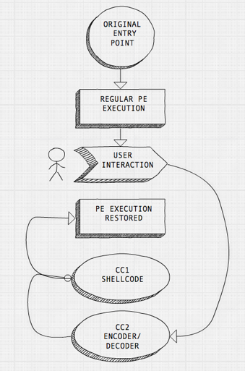
SAY HI TO JACK!
Where is best to hijack program execution?
ENTRY POINT > most AVs will detect it
TLS CALLBACKS > Stealthier?
USER INTERACTION > Stealthier?
Notes:
As a last bit, we have to think about how to force the original program execution into our malicous payload.
So the program will handover execution to our stub decoder + shellcode

Slide 10
[DEMO]
Notes:
as demo I was thinking about some tasty tiramisu recipe video on youtube, but I don’t want to spoil your hunger, so we stick to original plot.

Slide 11
[0x?]
Notes:
questions?

